Slide 1
Financial System

Slide 2
What is Financial System?
Complete and complex ever changing set of rules, regulations, procedures, practices policies, conducts, role of institutions (financial institution), Governments, Policy makers and central bank taken together may be called financial system.

Slide 3
What Financial System Does ?
Financial system channels funds from savers to borrowers, giving savers claims on borrowers’ future income.
The financial system brings together savers and borrowers in two ways.

Slide 4
Direct Finance through financial markets, individual savers hold the claims issued by individual borrowers.
Indirect Finance through financial intermediaries that are backed by their portfolio of assets, which are claims on the borrowers.

Slide 5
Financial markets provide play field to the financial instruments. Financial instruments are traded by household, business firms, government and foreigners in wide variety of financial markets or markets for financial instruments.
Financial market can at preliminary stage be termed as market for bonds and stock markets.

Slide 6
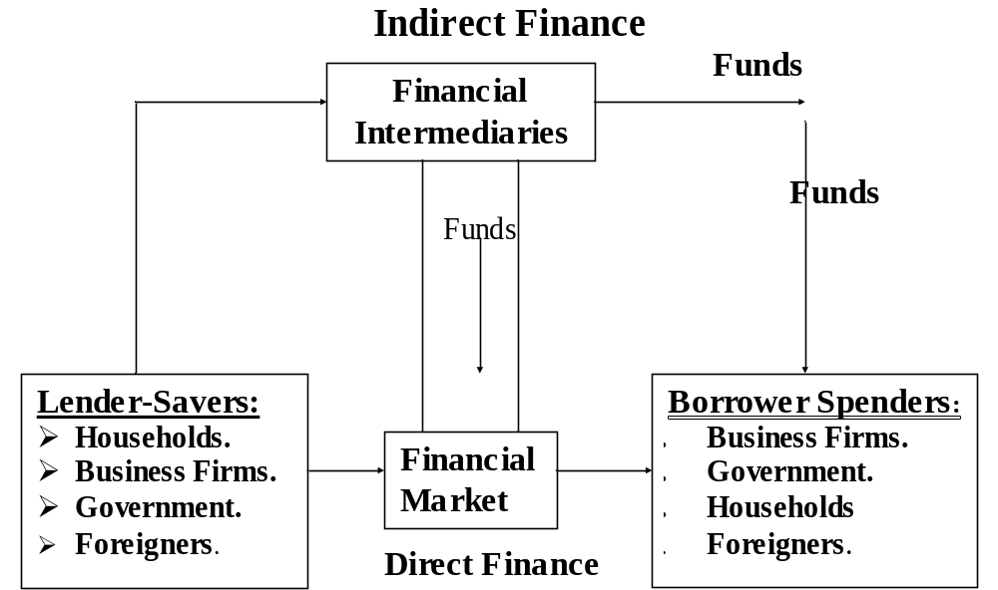
Functions of Financial Markets

Slide 7
Functions of Financial Markets
Those who have saved and lending funds, the Lender Savers are at the left side &
Those who must borrow funds to finance their spending, the Borrower-Spenders are at the right. The arrows show that Funds flow from lender savers to Borrower – spenders via two routes i.e.; through financial markets (Direct Finance) and through Financial intermediaries i.e. Banks etc. (Indirect Finance)

Slide 8
Functions of Financial Markets
In direct finance borrowers borrow funds directly from lenders in financial markets by selling them securities or bonds which are claim on borrowers future income or assets.

Slide 9
Why Channeling of Funds Important
  Because, the people who save are frequently not so enterprising to enter into profitable investment ventures.
Financial markets contribute to:
    Higher production.
    Efficiency in overall economy and economic welfare.

Slide 10
Financial Markets include the Following
Foreign exchange market.
Stock market.
Bond market.
Financial markets are one arena in which savers’ surpluses are transferred to borrowers. Savers can buy stocks and Bonds and Business borrowers can obtain funds by issuing stocks and Bonds

Slide 11
Financial Institutions: (Global Perspective)
Financial institutions are also called Financial Intermediaries and include:
Commercial Banks.
Credit Union
Savings and Loan Associations.
Mutual Funds.
Finance Companies.
Pension Funds etc.

Slide 12
Financial Institutions: (Global Perspective)
  The role of Financial Institution is to act as Financial Intermediary or to provide function of Financial Intermediation, role of go-between for savers and borrowers.
  Banks are the largest financial intermediaries. Banks lend to many sectors of the economy.
  However, banks and other financial institutions compete with one another and this competition has advantage for savers, borrowers and system as a whole.

Slide 13
Financial System (Institutions) Provide Three Key Services
Risk Sharing:
  For savers steady return (profit, interest) and
  For borrowers predictable cost (Interest payable by barrower).
Liquidity:
(Chequing Bank Accounts, Bonds and Stocks all are very liquid type of instruments. Enhance liquidity of financial system.

Slide 14
Financial System (Institutions) Provide Three Key Services
Information:
(Low Information Cost of services through Financial System). Information can be easily and at less cost available on borrower’s credit worthiness etc. through Banks/financial system.

Slide 15
Structure of Financial Market
  Financial markets are categorized as under:
  Debt and equity markets.
  (Primary Markets and secondary markets)
  2) Exchange markets and over-the-counter market. (OTC)
  3)Forward contracts and future markets.

Slide 16
Debt and Equity Markets
Debt instruments such as issuing bonds.
These may be:
Short term (Maturity less than one year)
Long-term (maturity ten year or longer)
Intermediate term (maturity between one and ten years).
Second method of raising funds is by issuing equities. ( Shares/Stocks)

Slide 17
Primary Market and Secondary Markets
  Primary Market is a financial market in which new issues of a security such as Bonds or stocks are sold to initial buyers.
  Secondary Markets: Further sale of already issued securities.

Slide 18
Exchange and Over-the-Counter Markets
Secondary Markets can be organized in the following ways :
Through organizing/establishing Stock Exchange and through Over-the-Counter (OTC) markets, (Dealers in these markets are in online contact and know the prices set by one another . OTC markets are very competitive.

Slide 19
Money Market and Capital Market
Money Market is a financial market which deals in short term debt instruments.
Capital market deals in long term debt instruments

Slide 20
Forward Contracts and Futures Market
Under Forward Contract. Buyers and/sellers agree to trade certain quantity of commodity for a specific price at a specified date in future, contracts are formally made in commodities exchange markets.
Globalization of Financial Market:
Capital mobility has enhanced, leading to economic development.

Slide 21
Financial Regulations
Respective Governments regulate financial markets and financial institutions around the world, which is necessary for the maintenance of financial stability, build confidence of all stake holders in the system.
There are also international norms, practices and protocols which are required to be observed by all participants, trading across the borders. (such as UCP and UCC)

Slide 22

Difference Between Money Market and Capital Market.

